Slide 1
Objective
High Level understanding of AI Pitfalls, & how to build trust in the system.

Slide 2
The AI Process
How could it go wrong?
Building Trust

Slide 3





Delivering value with AI takes five steps.
Business Strategy
Collect Data
Build & Validate a Model
Deploy the Technology
Continuous Monitoring
Pitfalls
“Sprinkle some AI on it.”
“Where’s the data?”
“How do we do this?”
“Throw it over the fence at IT.”
“Pop champagne we’re done!”

Slide 4











There are multiple stakeholders along this journey.
Business Strategy
Collect Data
Build & Validate a Model
Deploy the Technology
Continuous Monitoring
Senior Executives
Business Operations
Business Analysts
Data Engineers
Data Scientists
Software Developers
Dev Ops
IT
Business Users
Customers
Risk and Compliance
AI INNOVATORS
AI CREATORS
AI OPERATORS
AI CONSUMERS

Slide 5







Simple example of an AI Workflow.
Business Strategy
Collect Data
Build & Validate a Model
Deploy the Technology
Continuous Monitoring
“Predict how many ice cream cones we will sell each day.”
“Get historical price, temperature & seasonal data”
“Use machine learning!”
“Predictions are sent to our suppliers”
“We are partially closed due to the pandemic”

Slide 6
The AI Process
How could it go wrong?
Building Trust

Slide 7

Welcome to the dark side of data science

Slide 8
Fundamentally AI understanding is probabilistic.
Deterministic
Probabilistic
If you build a calculator it will always be correct.
If you build a model it will be wrong immediately.
2 + 2 = 4
2 + 2 = 99.99% Probability of 4
Why bother?
Most complex problems are not deterministic.
The world isn’t B/W.

Slide 9





Let’s put a model into production.
Business Strategy
Collect Data
Build & Validate a Model
Deploy the Technology
“Is this applicant qualified?”
“Edu, Employment Type, Employment Length”
“Use machine learning!”
Build a webapp for personnel.

Slide 10
Machine Learning Reviews Qualifications as a Range of Possibilities.
Definitely Not Qualified
Definitely Qualified
0.00
1.0
Where to place the green dot?

Slide 11
Machine Learning Reviews Qualifications as a Range of Possibilities.
Definitely Not Qualified
Definitely Qualified
0.00
1.0
Where to place the green dot?
Too high & you will not interview enough people.

Slide 12
Machine Learning Reviews Qualifications as a Range of Possibilities.
Definitely Not Qualified
Definitely Qualified
0.00
1.0
Where to place the green dot?
Too low & you will interview a lot of unqualified people.

Slide 13
Machine Learning Reviews Qualifications as a Range of Possibilities.
0.00
1.0
Reality:
Not Qualified
Reality: Qualified
Interviews offered but candidate was not qualified.

Slide 14
Machine Learning Reviews Qualifications as a Range of Possibilities.
0.00
1.0
Reality:
Not Qualified
Reality: Qualified
Missed opportunity to interview qualified candidates.

Slide 15

Similar individuals near the dot get different outcomes.
Expected not to be qualified
Bachelor’s, Analyst, 24M
Expected to Be Qualified
Bachelor’s, Sr. Analyst, 20M

Slide 16
The model has been running in the background, let’s review outcomes.
Actual Results
0.00
1.0
ACTUAL Qualified
ACTUAL not Qualified
2 Success + 6 Unqualified = 8 out of 12

Slide 17
Using the historical outcomes, where should we put the green line. Let’s make sure we are fair by two groups.
GroupA
0.00
1.0
GroupB
0.00
1.0
ACTUAL Qualified
Group A: 1 Success & 3 Unqualified of 6
Group B: 1 Success & 3 Unqualified of 6
Overall Accuracy: “YEAH, the model is fair!”
ACTUAL not Qualified

Slide 18
Maybe we should prioritize accuracy within qualified candidates.
GroupA
0.00
1.0
GroupB
0.00
1.0
ACTUAL Qualified
Group A: 1 Success of 3
Group B: 1 Success of 2
Success Accuracy: “Ooops, the model success isn’t fair!”
ACTUAL not Qualified
Notes:
True Positive Rate

Slide 19
Now the hiring rate is the same for both groups (1 of 3) within the qualified candidates.
GroupA
0.00
1.0
GroupB
0.00
1.0
ACTUAL Qualified
Now the model has “equal success/representation”
ACTUAL not Qualified
1 success & 2 unqualified per group to the right of the line.

Slide 20
Let’s focus on the rate of disqualification.
GroupA
0.00
1.0
GroupB
0.00
1.0
ACTUAL Qualified
Group A: 3 Unqualified of 3
Group B: 3 Unqualified of 4
Unqualified Accuracy: “Ooops model “unqualified rate” isn’t fair.”
ACTUAL not Qualified

Slide 21
Now the unqualified accuracy is equal, 3 of 4.
GroupA
0.00
1.0
GroupB
0.00
1.0
ACTUAL Qualified
ACTUAL not Qualified
Now the model has “equal disqualification/error rate”
3 disqualifications of 4…but now no one in group A is qualified!

Slide 22
Fairness is complicated.
Success, failure, or overall accuracy by gender, race, ethnicity, language, religion, disability, age, sexual orientation, pregnancy, political opinion, medical record, criminal record, marital relationship status, trade union activity, genetic information...

Slide 23
Technology Ethics has additional considerations
What about displacing labor?
AI can increase employee satisfaction by handling routine tasks
Free up time for more value-add work
Modeling context matters
Medical classifications vs ad banners vs news feeds vs dating suggestions vs song recommendations...
Amplification
Speed and impact has increased which can amplify systemic issues
Stakeholder context
Modeling at-risk populations & unintended consequences
Tools to oppress
State sponsored persecution and surveillance

Slide 24
The AI Process
How could it go wrong?
Building Trust

Slide 25

One does not simply add ethics to technology

Slide 26

It’s easy to find examples of lost trust in AI.
Lending algorithms can limit credit based on gender.
Medical diagnostic algorithms may hinder treatments for people of color or over promise their effectiveness.
AI recruiting tools can reinforce biased historical hiring practices.
Facial recognition software can misidentify people of color.
Advertising algorithms can amplify unfair practices in housing and employment.
AI can identify historical patterns in education reinforcing class divisions.

Slide 27
Remember this?
Business Strategy
Collect Data
Build & Validate a Model
Deploy the Technology
Continuous Monitoring
!
!
!
!
!
!
!
!
!
!
!
Senior Executives
Business Operations
Business Analysts
Data Engineers
Data Scientists
Software Developers
Dev Ops
IT
Business Users
Customers
Risk and Compliance
AI INNOVATORS
AI CREATORS
AI OPERATORS
AI CONSUMERS
For each person, earning trust means something different.

Slide 28
Trust must be pervasive in the entire system.
Business Strategy
Collect Data
Build & Validate a Model
Deploy the Technology
Continuous Monitoring
Senior Executives
Business Operations
Business Analysts
Data Engineers
Data Scientists
Software Developers
Dev Ops
IT
Business Users
Customers
Risk and Compliance
AI INNOVATORS
AI CREATORS
AI OPERATORS
AI CONSUMERS

Slide 29
Three core components
1. Understanding - Define hazards and thresholds
2. Action - Guardrails to mitigate hazard likelihood & severity
3. Explanations - Communicate risk behaviors & events, i.e. compliance documentation & visualizations

Slide 30
Understanding: Define hazards, identify risks & plan mitigations.
In all automated decisions, humans are empowered & have a role to play
Decision Type I
Decision Type II
Decision Type III
Risk Size
Loss <$100K
$100K < Loss < $1m or Injury
Loss > $1m or death
Example
Probability of a banner ad click
Probability of Mortgage Default
Medical imaging scanning
Construction, Maintenance & Monitoring
Type I
Risk Assessment & Mitigation
Human Role
Type I, II
Final Augmented decision outcome

Slide 31
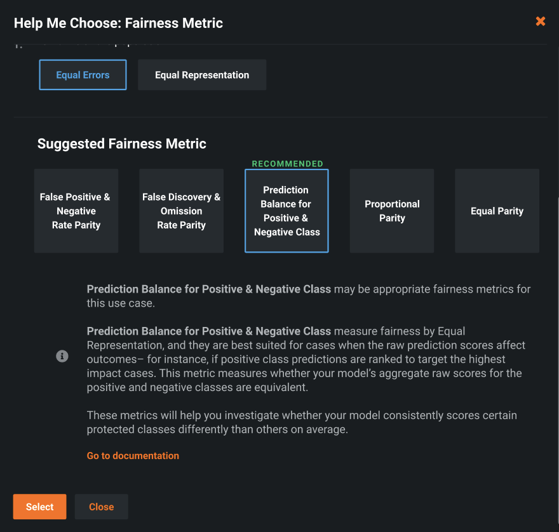
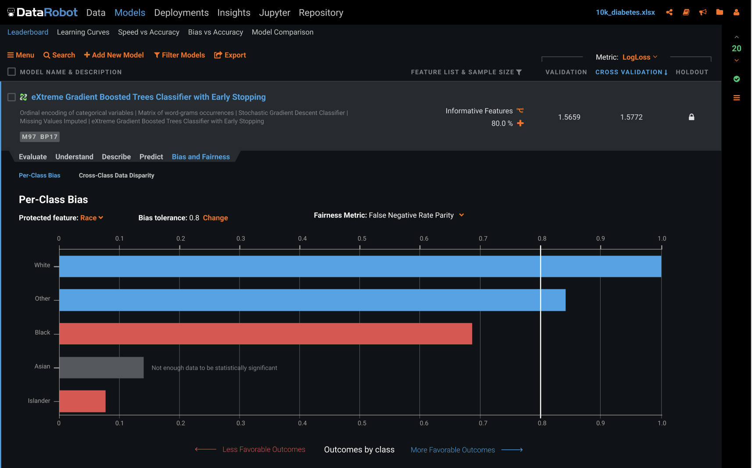
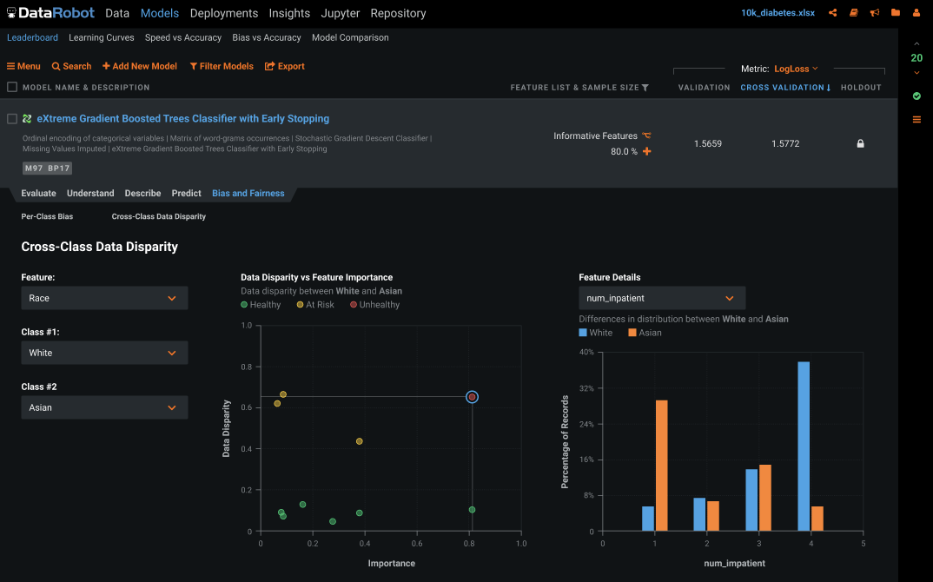
Action: technological guardrails
The right tools can assist in carrying out the identification and mitigation of those risks.
Notes:
Managerial dashboard that we are building has this information surfaced directly to you from the model.

Slide 32



Trusted AI requires people, process & technology.
Planning & Processes
Technology
Integrating project planning, and risk mitigation management into AI decision systems is foundational.
AI Innovators, Creators, Operators & Consumers
A systemic platform approach ensures auditability, scalability and consistency.
Humans create, maintain & govern AI systems in addition to being affected by AI outcomes.

